Slide 1
Today’s Topics
Prelim cum Mains Preparation
7 days duty: How to read theHindu
Why read Hindu? Direct Qs coming
Without proper tech.,
4-5 hrs wasted= player begins to ignore

Slide 2
Prelims 2015
CSE-2015
25. Which one of the following was given classical language status recently?
(a) Odia
(b) Konkani
(c) Bhojpuri
(d) Assamese
2015 March
www.thehindu.com/news/national/kerala/classical-tag-to-malayalam-odia-challenged/article6960955.ece

Slide 3
PRE-2015
CSE-2015
100. Indira Gandhi Prize for Peace, Disarmament and Development for 2014 was given to which one of the following?
(a) Bhabha Atomic Research Centre
(b) Indian Institute of Science
(c) Indian Space Research Organization
(d) Tata Institute of Fundamental research
Answer is "C" ISRO as per TheHindu Nov. 2014 http://www.thehindu.com/news/national/isro-chosen-for-indira-gandhi-prize-for-peace-disarmament/article6614424.ece

Slide 4
Doesn’t mean always direct Qs come
CSE-2015
80. 'IceCube', a particle detector located at South Pole:
1. It is the world's largest neutrino detector, encompassing a cubic kilometre of ice.
2. It is a powerful telescope to search for dark matter.
3. It is buried deep in the ice.
Correct Statement
(a) 1 only (b) 2 & 3 only (c) 1 & 3 only (d) 1, 2& 3

Slide 5

Although Q. was difficult
CSE-2015
1st statement is right as per Hindu Jan.2015 http://www.thehindu.com/news/national/students-to-take-virtual-tour-of-south-pole/article6781535.ece
2nd statement is right as per http://phys.org/news/2013-11-world-largest-particle-detector-icecube.html
3rd statement is right as per Hindu 2013 From <http://www.thehindu.com/sci-tech/science/highenergy-neutrinos-from-alien-sources-found/article5397965.ece>
Hence answer "D" all correct.

Slide 6
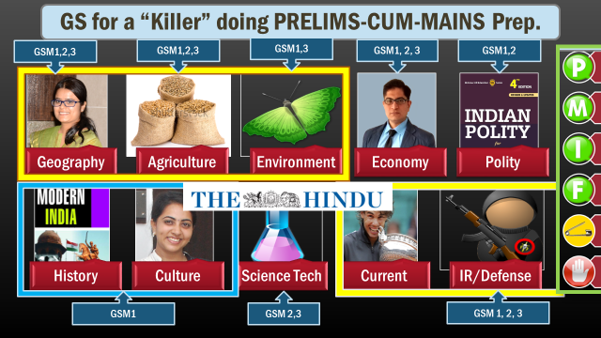
Whenever reading theHindu- Visualize
Prelims
Mains
Interview
Fodder
Cost: benefit …x
PIN: Person, place, books, authors, awards, BizGK, Sports

Slide 7
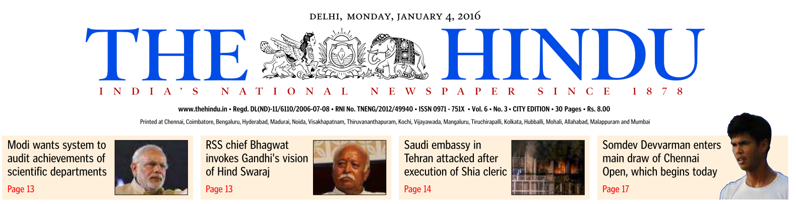



Slide 8
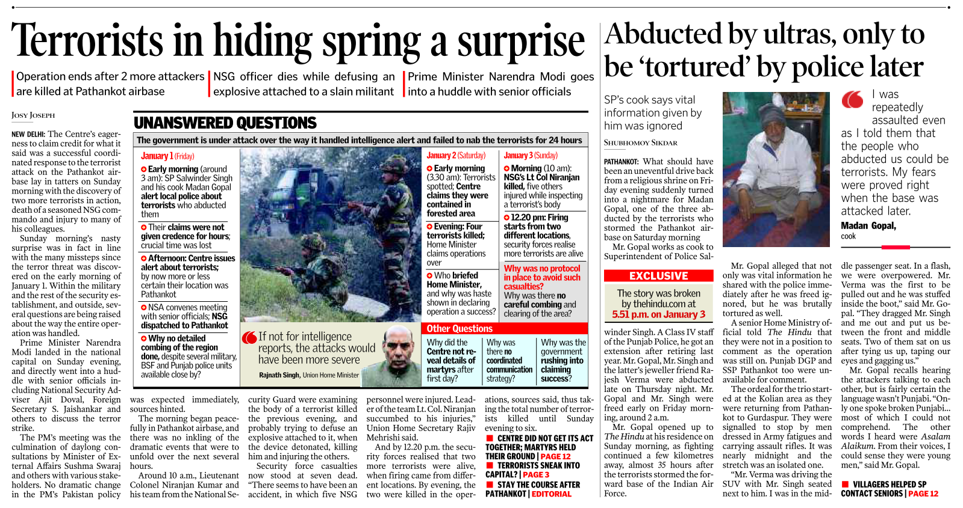



Slide 9
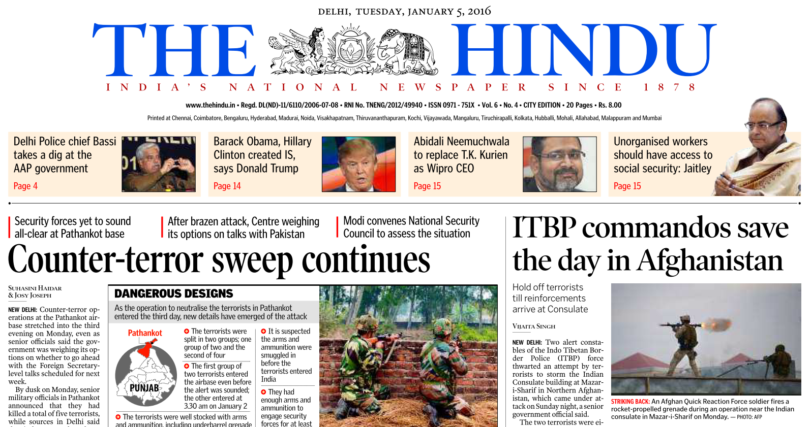
Notes:
Day 2 day blall by ball will continue.

Slide 10
Pathankot
Prelims: Map location of Pathankot, which river passes, which wild life sanctuary?
GS3: forces- DSC (Defense Security Corps)
Jaish – but Pak army not willing to act on “Kashmir centric groups”
Interview-SRT: would it be better to use locally available army than wait for NSG?
Interview: Should we continue dialogue with Pak?

Slide 11
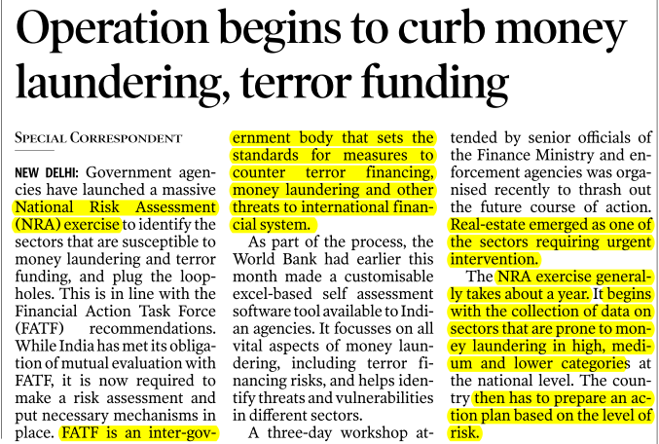
NRA exercise
Same for coaching industry

Slide 12



Let the report come
Notes:
F: intoleranace is increasing
? – turn to page13

Slide 13



Slide 14
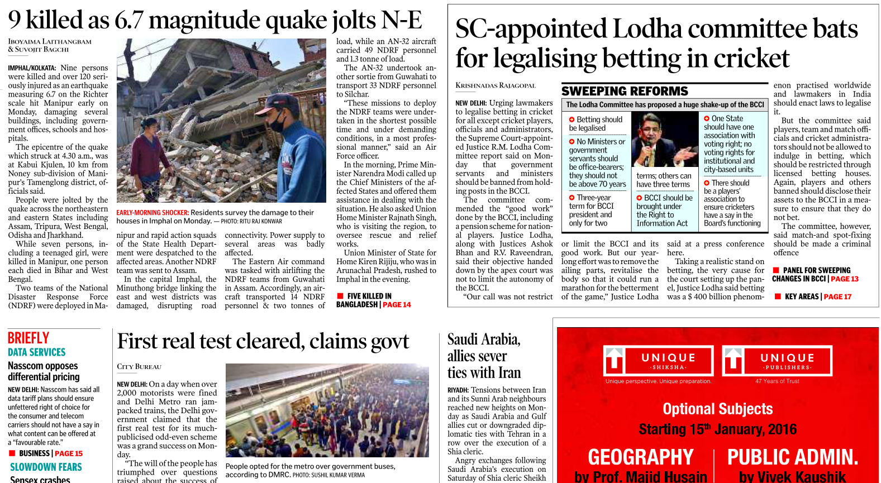
How is it affecting Indian interests (GS2): oil + workers
Once u get the basic idea

Slide 15
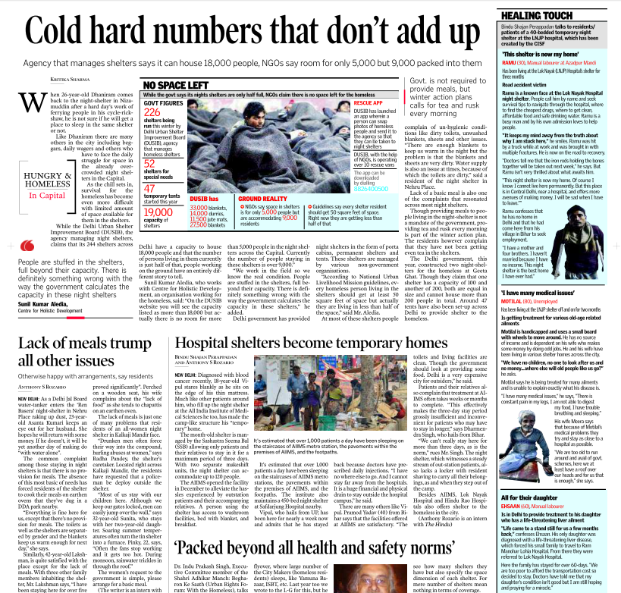
Page 2 to 7: fast forward possible
2: full page ad/ Delhi
3-4-5: Delhi stuff
6: coaching ads
7: Delhi / Northern region
Notes:
15-aug, 26 jan= travel arrangement, dengue etc.- more money spent in ads than in cure.
Northern region- if stomach not full with criminal within Delhi. And not enough ads.

Slide 16
Whether its relevant in PMIF framework?
Delhi & N.India
hospital, water, pollution (NGT), muni issues
VAT hike and rollbacks
Court proceedings on individual small cases, UGC clerks accepting bribes
Women security, Petty crimes, fires, theft, accidents, road-rage
AAP vs BJP; Lokayukta
ISIS Joining
Homeless deaths, UGC clerks accepting bribes.

Slide 17

Muni issues in Delhi: Jan 2016
Art. 276
Professional tax
By state/ local govt.
Upto Rs.2500 per year per person
(sidenote) 14th FC recommended raising it. otherwise deficit in governance.
Tricky MCQs possible
Notes:
Tricky MCQs possible.

Slide 18
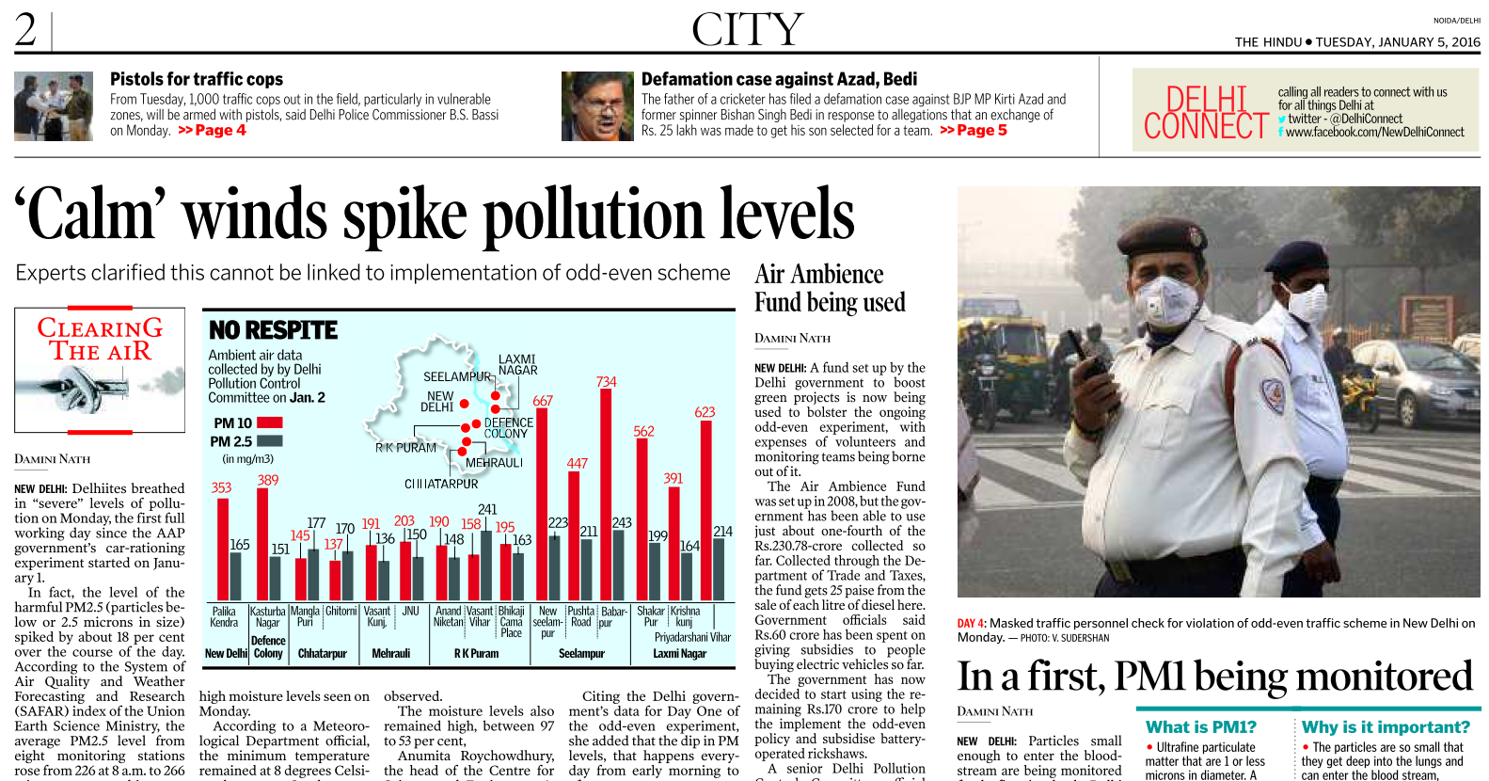
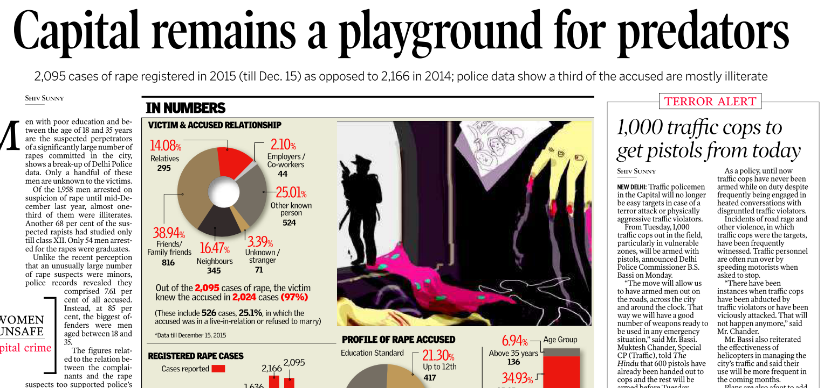
Tuesday: 5th Jan 2015
2-3-4-5: Delhi stuff
6: coaching ads
7: Delhi stuff / Northern region
Usually: hospital, women security, traffic, road rage, pollution, AAP vs BJP, admission, JNU/DU-issues

Slide 19
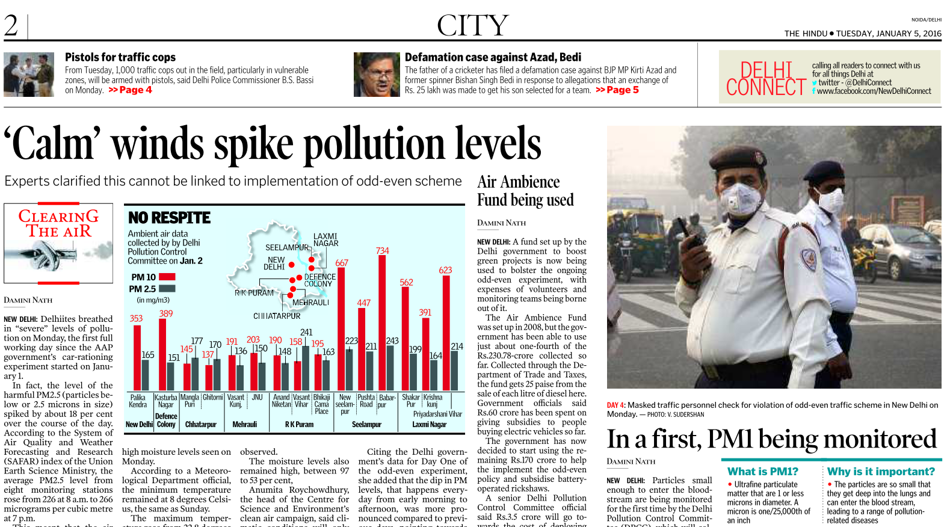


Slide 20
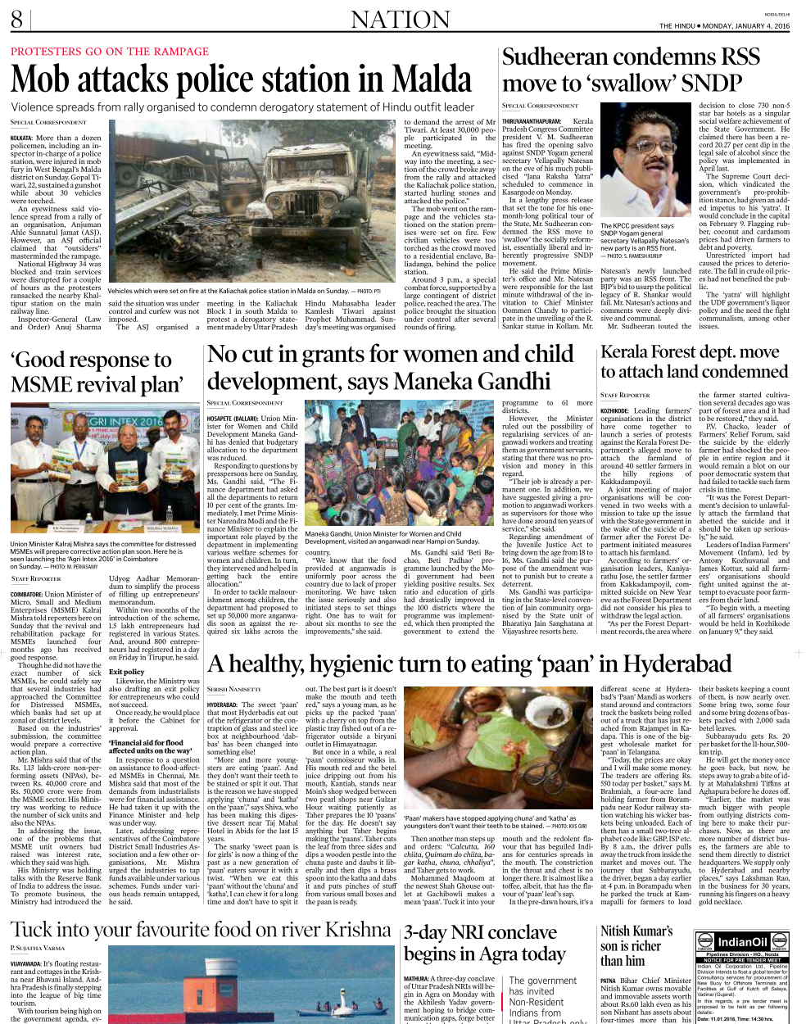
2-7: Delhi, ads; Page 8-9: Nation
“Space” of nation depends on
# of tenders and job ads
News from South India
Notes:
Paan – beetle leaves.

Slide 21

Tuesday Page 8-9: Nation(!?)
“Space” of nation depends on
# of tenders and job ads
News from South India

Slide 22
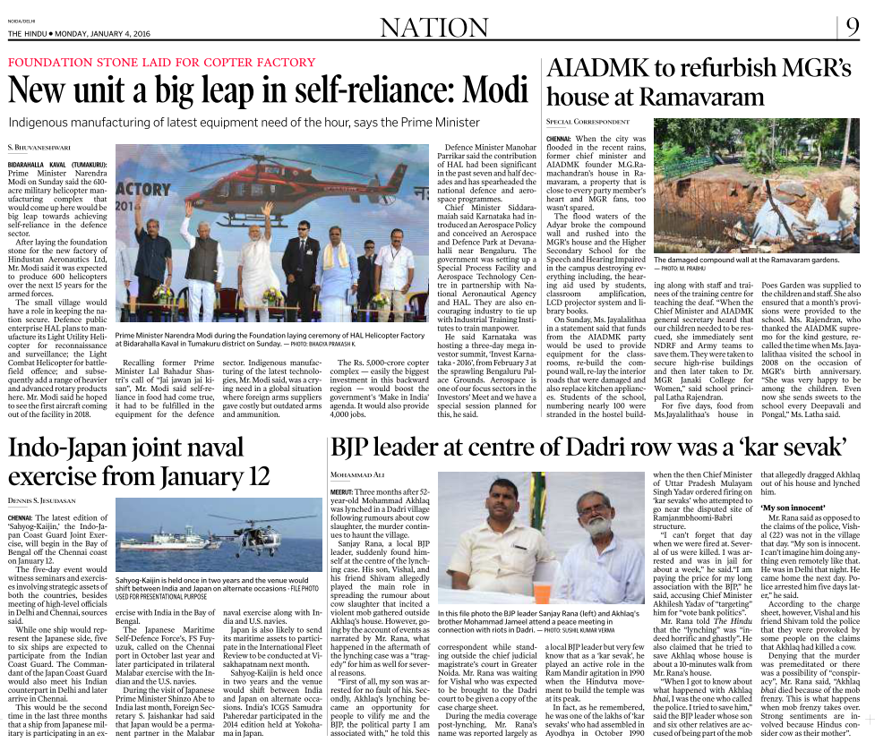


Slide 23
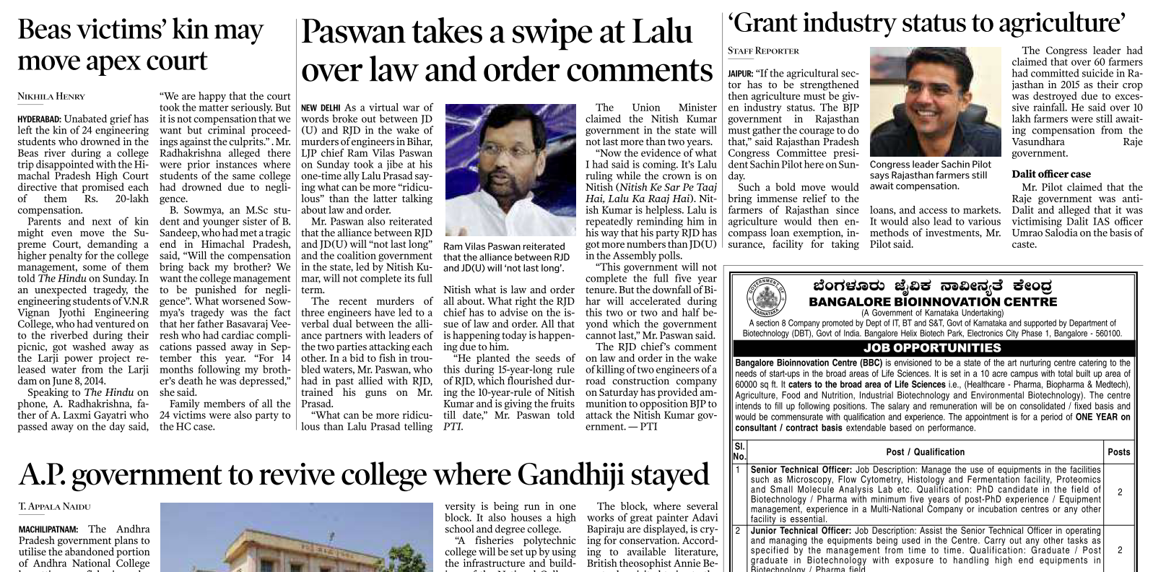
Individual crime
Political tu-tu mein-mein
Wait for Eco. survey

Slide 24
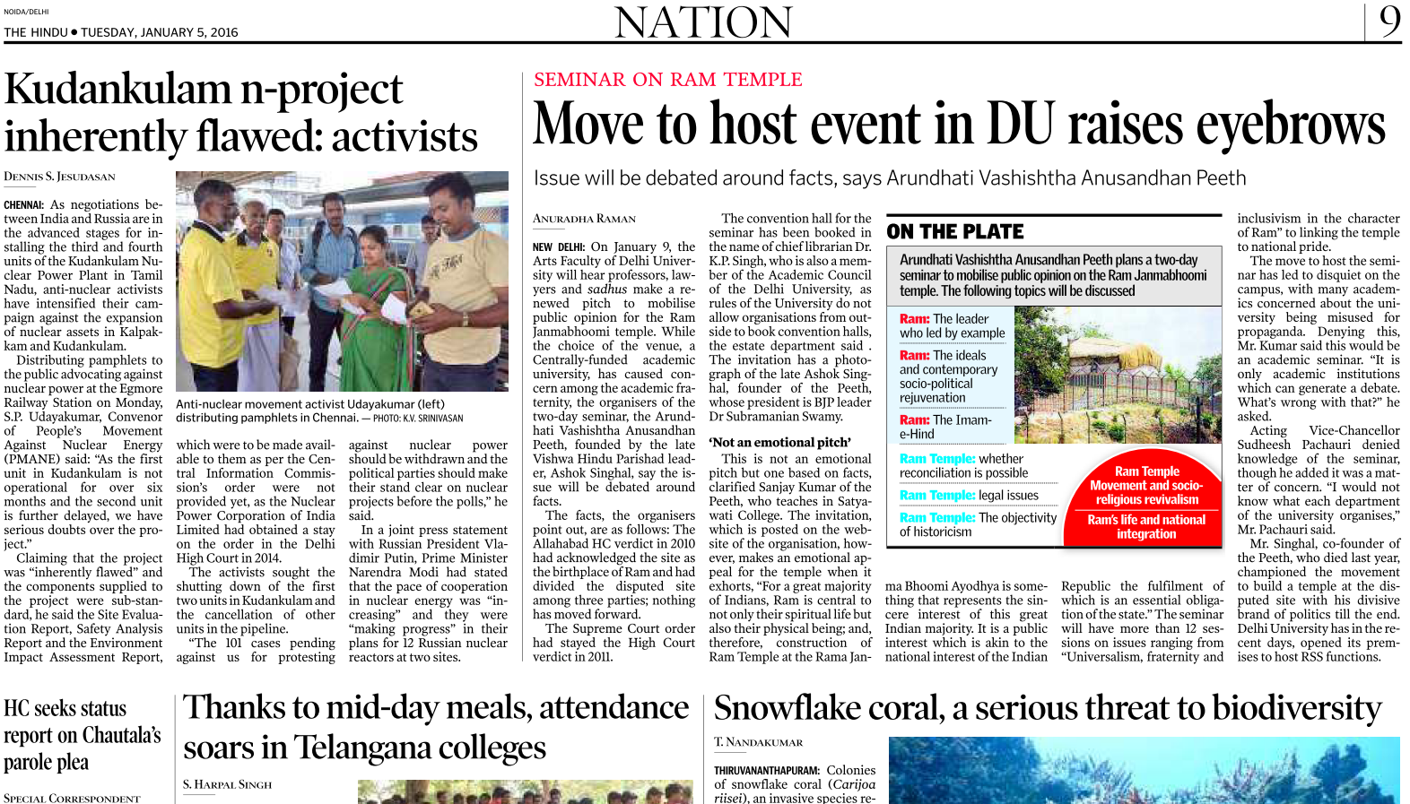

Political tu-tu mein mein
Once u get basic idea
Which nation providing technology, what type of reactor used?

Slide 25
Snowflake Coral
Notes making
Snowflake Coral (Carijoa riisei) is bad
Attaches with metal, concrete, plastic in sea
Takes way the space, nutrition other marine species.
Crowds out corals, sponges, algae, ascidians.
marine biodiversity ▼
Where? first reported in Hawai in the early-70s and since spread across Aus, Thailand etc.
In India, Gulf of Mannar, Kutch, Goa, the Andaman and Nicobar Islands, Thiruvanthampuram, Kanyakumari also suffering
hence considered "invasive" alien species.

Slide 26
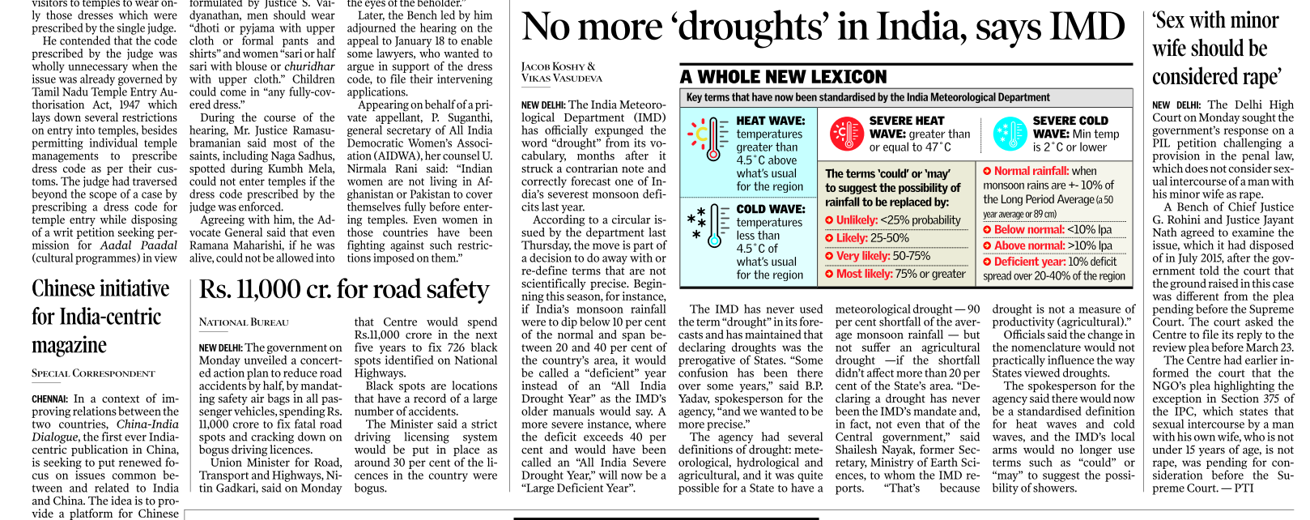

Slide 27
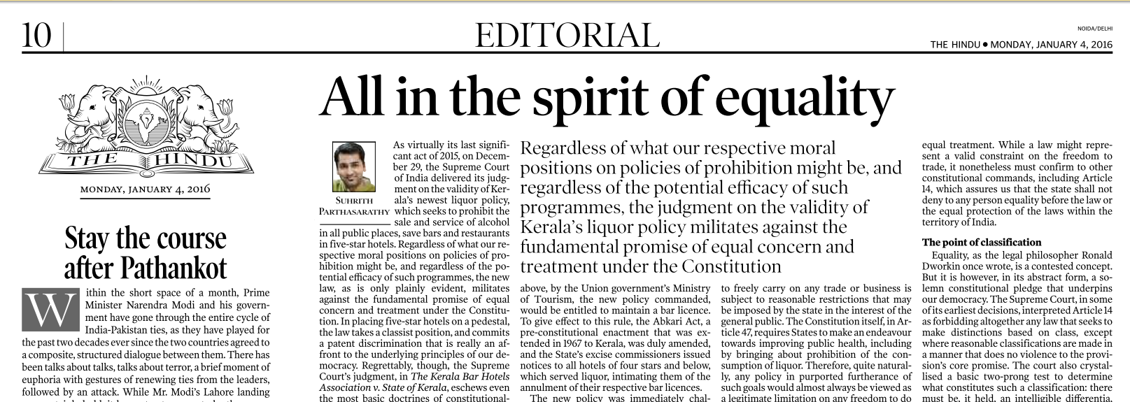

Slide 28
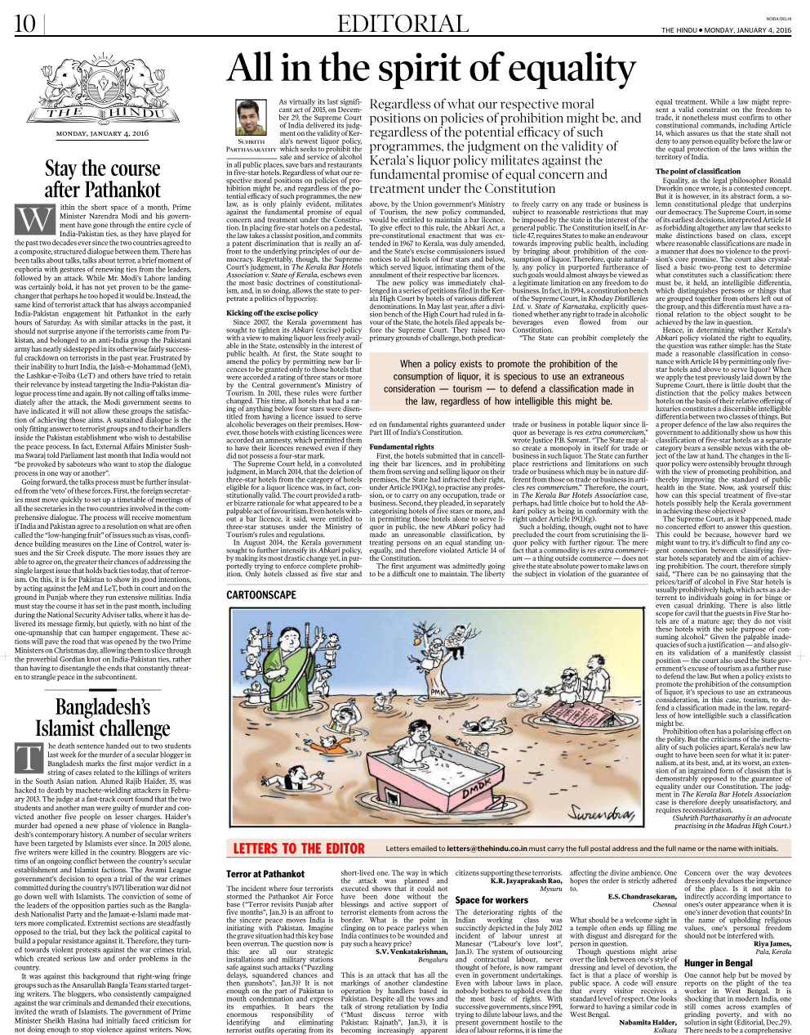
Editorial: All in the spirit of equality (Click me)
Read passages and letters to editor for ▲ vocabulary and language/reasoning
Fodder Points for Essay, Ethics, GDPI

Slide 29
Gist of Editorial: All in the spirit of equality (Click me)
SC validates- Kerala’s newest liquor policy: Noone can sell alcohol, except 5 star hotels.
But authors feels unhappy with judgement
res extra commercium (google): a thing outside commerce. Liquor, betting, crime- there can't be "business in crime". Liquor also res extra commercium- said SC in another judgement.
Selective application will not be right.
Art. 14 violated- No equal protection of law. 5 star vs. 4 star.
Art. 19/1/g violated- lower hotels no freedom of profession.
Art. 47 followed- state can improve public health- very few will buy expensive. (counter- what about VIP drinking in 5 star).
Notes:
Service tax and visiting card not possible.

Slide 30
Editorial- all in the spirit of equality
Original
3 page of A4
1600 words
Gist
1/3rd of an A4
100 words
P+M+I revision
Revision difficult
Ball by ball, timelines
Writing practice
Notes:
Handwritten better.
Luxor- 5 page.

Slide 31
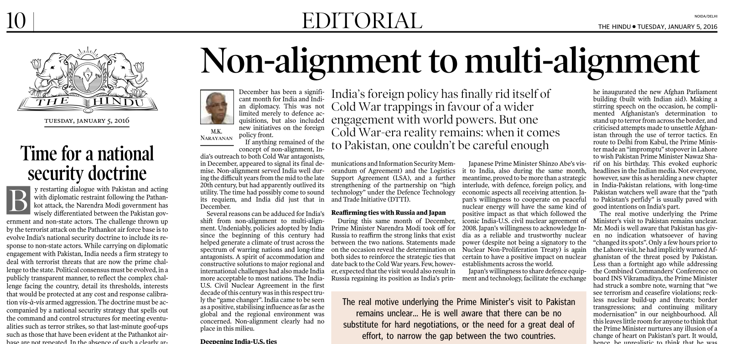
Because UPSC Panelists would read it

Slide 32
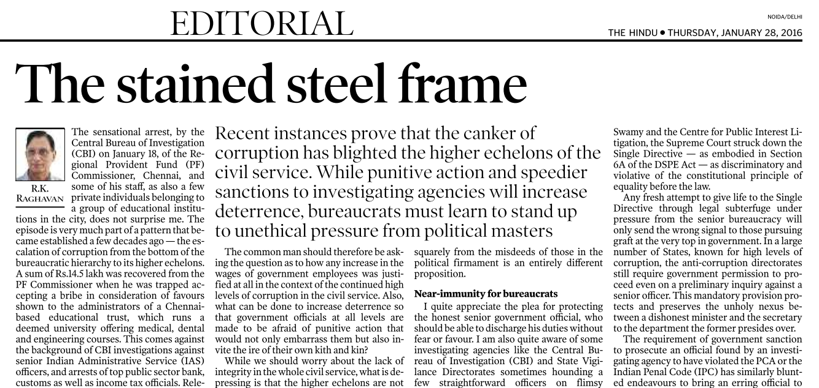
Because UPSC Panelists would read it

Slide 33
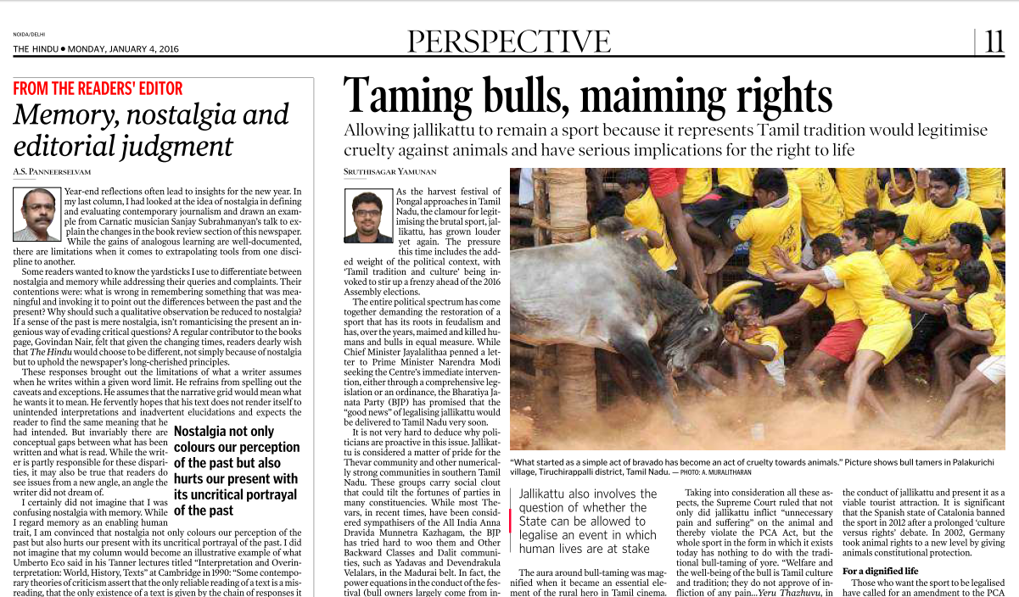
Journalistic Ethics
1 year past its expiry date?
Notes:
Journalistic Ethics.

Slide 34
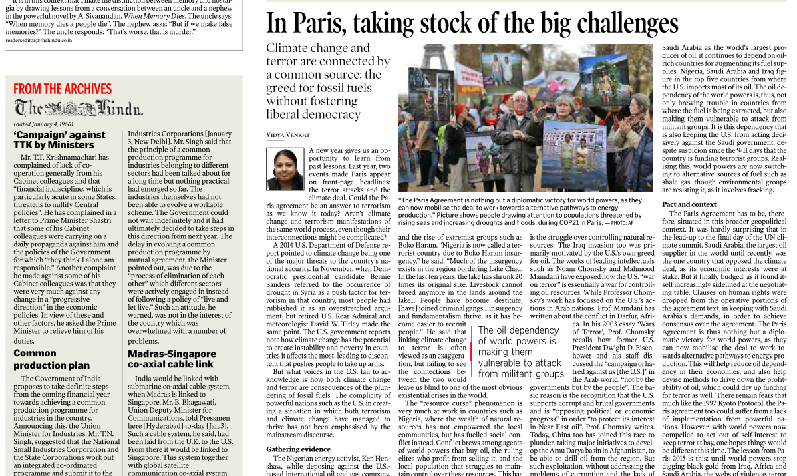
Once you get basic idea of Paris Summit
Post independence india??

Slide 35
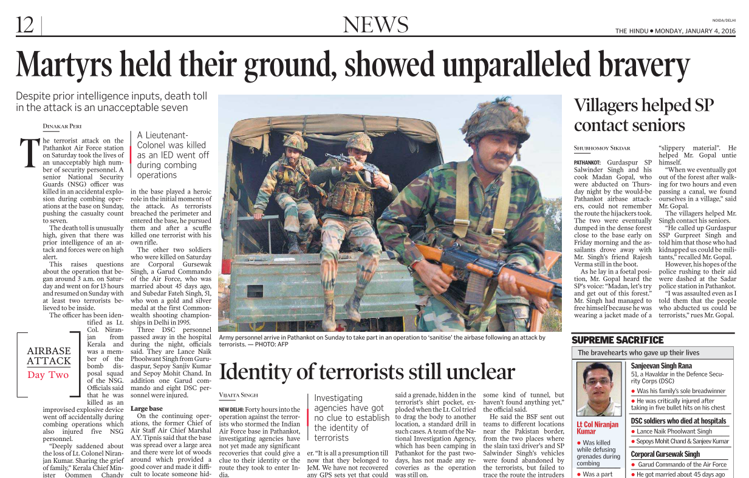

Slide 36
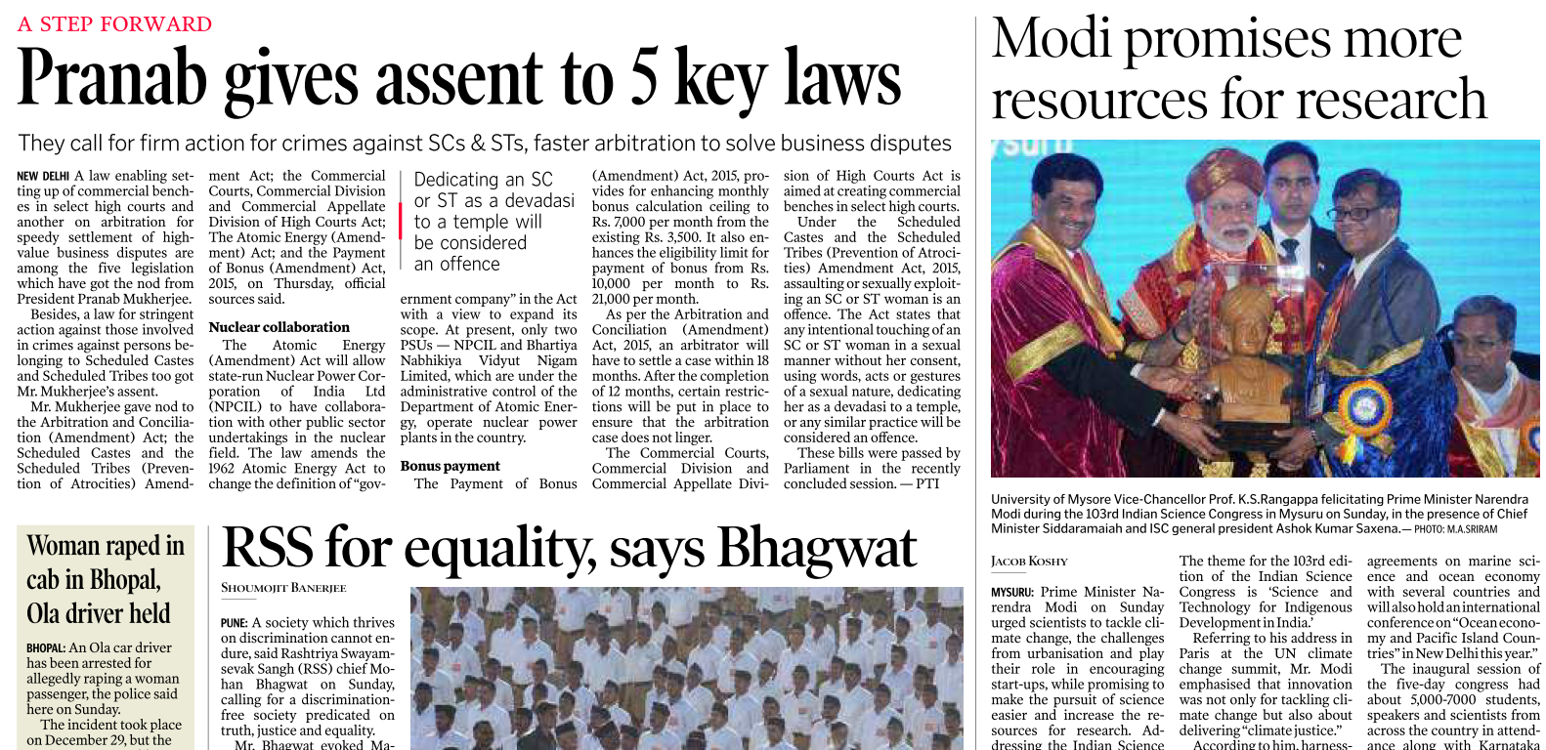
PRSindia.org
Venue and theme

Slide 37
Indian Science congress
PRE: 2016's Indian Science Congress (ISC) held in Mysuru, Karnataka. Theme- science & technology for indigenous development for India
INTERVIEW: Nobel recipient Venkatraman Ramakrishnan (Venki) says, "Indian Science Congress (ISC) is a “circus” and I shall never attend it again." He's angry over the "Fringe scientists“ e.g.
Detailed plans of airplanes available in Ancient Indian literature
Lord Shiva was a great environmentalist
Blowing of Shankh: an indigenous tradition for fitness and wellness.
Such things are discouraging real scientists from ISRO and elsewhere, whose real achievements are not highlighted by media.

Slide 38
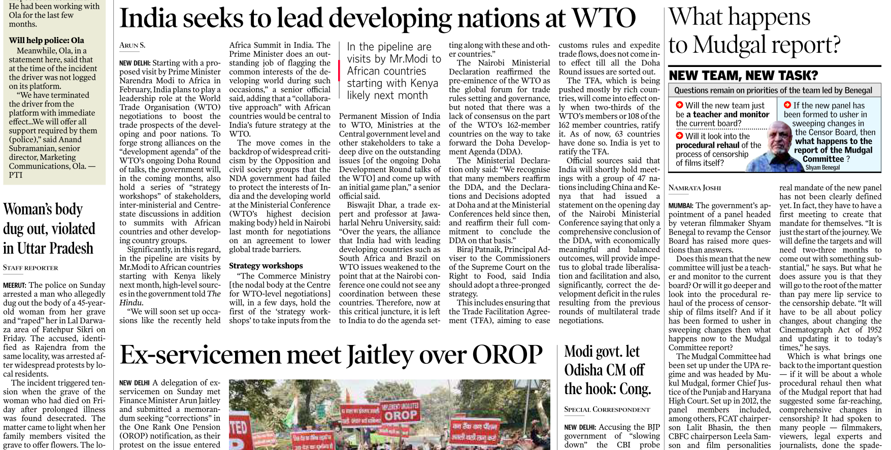
Follow when exact summit / conference takes place

Slide 39
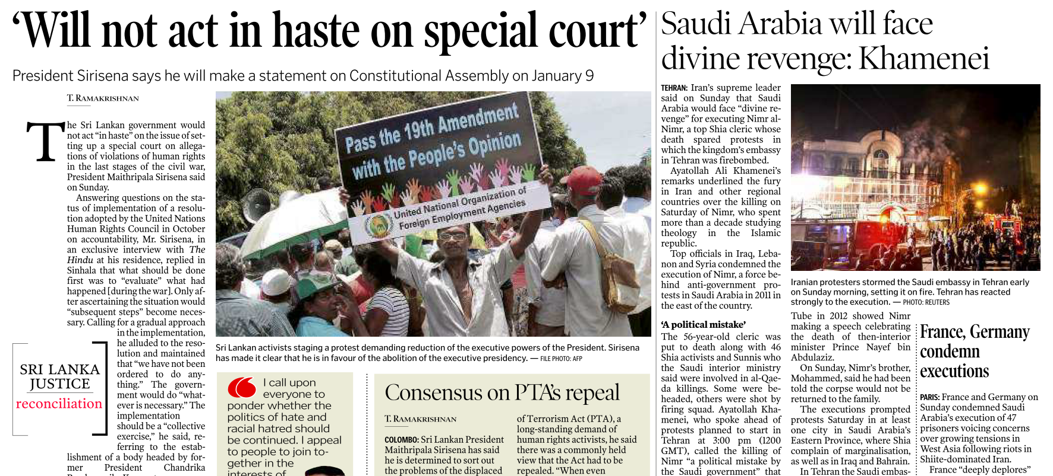
Once you know the gist of SriLankan Tamil issue, no need for daily commentary
How is this affecting Indian interest?

Slide 40

When you know basics, no need for daily followup
Max utility as a fodder in mains/interview
When you know basics, no need for daily followup

Slide 41

US-China, but affecting India as well (GS2)
Notes:
Direct mains question unlikely.

Slide 42
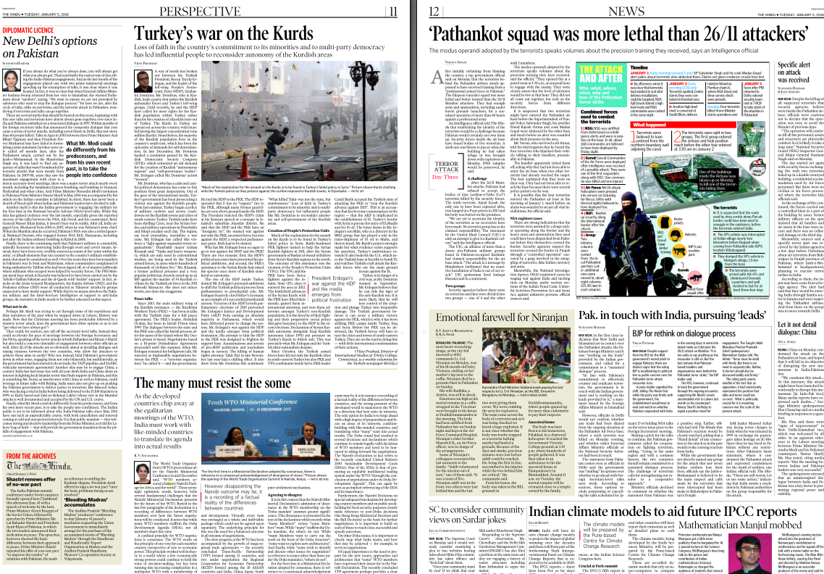
Once you get basics
Let the summit happen

